Slide 1
Lecture 12
IPC Unix Case Study – Named Pipes
National University of
Computer & Emerging Sciences

Slide 2
File Descriptors
The PCB of each process contains a pointer to a file_struct, a kernel-resident array data structure containing the details of open files
PCB
file_struct
files
…
file
fd[0]
fd[1]
f_mode
.
…
f_pos
f_inode
f_op
fd[255]
…
…
File operation routines

Slide 3
File Descriptors
The files_struct contains pointers to file data structures
Each one describes a file being used by this process.
f_mode: describes file mode, read only, read and write or write only.
f_pos: holds the position in the file where the next read or write operation will occur.
f_inode: points at the actual file

Slide 4
File Descriptors
Every time a file is opened, one of the free file pointers in the files_struct is used to point to the new file structure.
Linux processes expect three file descriptors to be open when they start.
These are known as standard input, standard output and standard error

Slide 5
File Descriptors
The program treat them all as files.
These three are usually inherited from the creating parent process.
All accesses to files are via standard system calls which pass or return file descriptors.
standard input, standard output and standard error have file descriptors 0, 1 and 2.

Slide 6
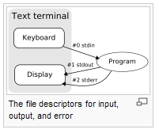

Slide 7
File Descriptors
char buffer[10];
Read from standard input (by default it is keyboard)
  read(0,buffer,5);
Write to standard output (by default is is monitor))
  write(1,buffer,5);
By changing the file descriptors we can write to files
fread/fwrite etc are wrappers around the above read/write functions

Slide 8
The Unix fact
When Unix programs do any sort of I/O, they do it by reading or writing to a file descriptor
A file descriptor is simply an integer associated with an open file

Slide 9
The Unix fact
A file in Unix can be
  A network connection
  A FIFO queue
  A pipe
  A terminal
  A real on-the-disk file
  Or just about anything else

Slide 10
EVERYTHING IN UNIX IS A FILE!

Slide 11
Reading/Writing from/to a Pipe
int read(int filedescriptor, char *buffer, int bytetoread);
int write(int filedescriptor,char *buffer,int bytetowrite);

Slide 12
NamedPipes
A FIFO is similar to a pipe. A FIFO (First In First Out) is a one-way flow of data. FIFOs have a name, so unrelated processes can share the FIFO. FIFO is a named pipe. This is the main difference between pipes and FIFOs.
Notes:
n 0666:
0: No special permissions are set.
6: For the owner (read and write permissions: rw-).
6: For the group (read and write permissions: rw-).
6: For others (read and write permissions: rw-).
Thus, 0666 means that everyone (owner, group, and others) has read and write permissions, but no one has execute permission.

Slide 13
mkfifo
int mkfifo(const char *pathname, mode_t mode);
  pathname – a UNIX pathname (path and filename).
  The name of the FIFO mode – the file permission bits.
    0: No special permissions are set.
    6: For the owner (read and write permissions: rw-).
    6: For the group (read and write permissions: rw-).
    6: For others (read and write permissions: rw-).
Thus, 0666 means that everyone (owner, group, and others) has read and write permissions, but no one has execute permission.
Notes:
n 0666:
0: No special permissions are set.
6: For the owner (read and write permissions: rw-).
6: For the group (read and write permissions: rw-).
6: For others (read and write permissions: rw-).
Thus, 0666 means that everyone (owner, group, and others) has read and write permissions, but no one has execute permission.

Slide 14
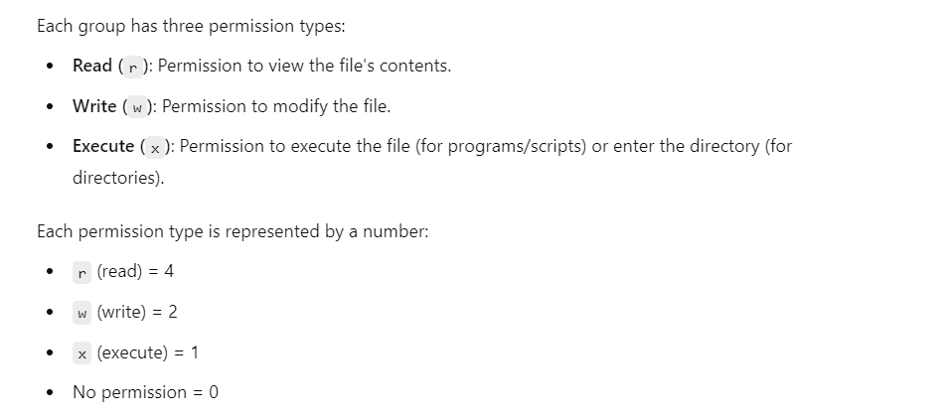
Makefifo()

Slide 15
mkfifo
1- After a FIFO is created, it can be opened for read or write.
2) Normally, opening a FIFO for read or write, it blocks until another process opens it for write or read.
3) A read gets as much data as it requests or as much data as the FIFO has, whichever is less.
4) A write to a FIFO is atomic, as long as the write does not exceed the capacity of the FIFO. The capacity is at least 4k

Slide 16
FIFO file
A FIFO (named pipe) file created using mkfifo() appears in the filesystem,
it does not store data on disk like a regular file.
Instead, the data flows through kernel memory (typically in a buffer in RAM) when processes read from and write to the FIFO.

Slide 17
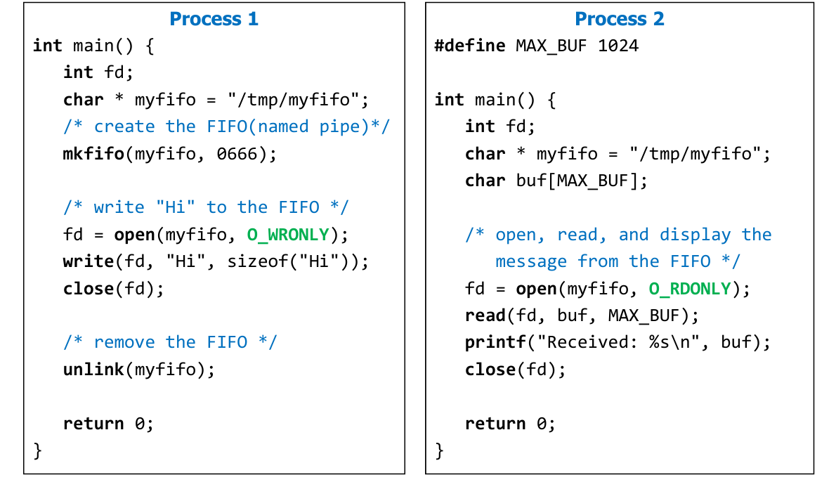

Named Pipe Example

Slide 18
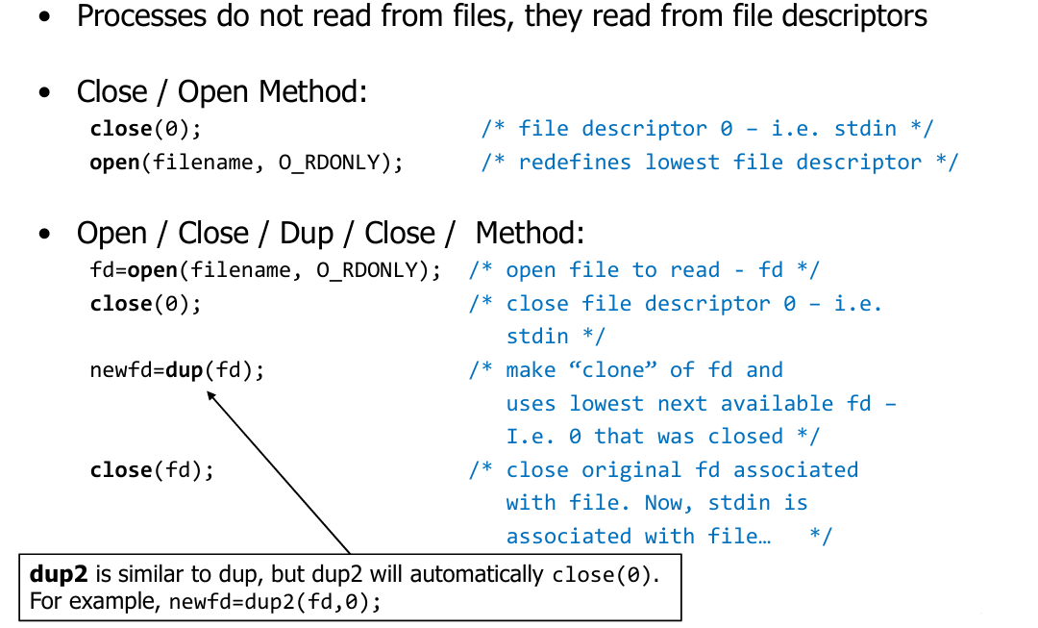
Redirection in C Programs

Slide 19
dup
duplicate an open file descriptor
fd_new = dup(int fd);
dup() takes the old file descriptor as the input parameter.
On success, it returns the lowest-numbered unused file descriptor as the new file descriptor.

Slide 20
dup
The dup() function, provided by the unistd.h library, is used in C programs to allow processes to duplicate existing file descriptors.
The dup() function replaces the lowest-level unused file descriptor to place the copied file descriptor.

Slide 21
dup
As for open(), the LOWEST unused file descriptor should be returned.
Upon successful completion a non-negative integer, namely the file descriptor, shall be returned;
otherwise, -1 shall be returned to indicate the error

Slide 22
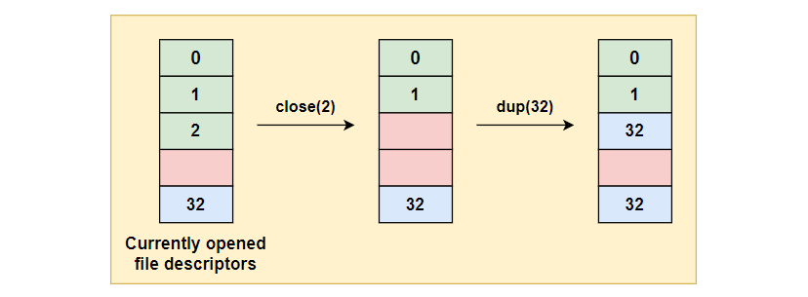
dup

Slide 23
dup
#include <stdio.h>
#include <unistd.h>
int main() {
int file = open("output.txt", O_WRONLY | O_CREAT , 0644);
if (file < 0) {
perror("open");
return 1;
}
int copy_fd = dup(file); // Creates a duplicate of file descriptor
write(copy_fd, "Hello, dup!\n", 12); // Writing using the duplicate fd
close(file);
close(copy_fd);
return 0;
}
Notes:
The file descriptor for output.txt is duplicated.
copy_fd can also write to the file, just like file.

Slide 24
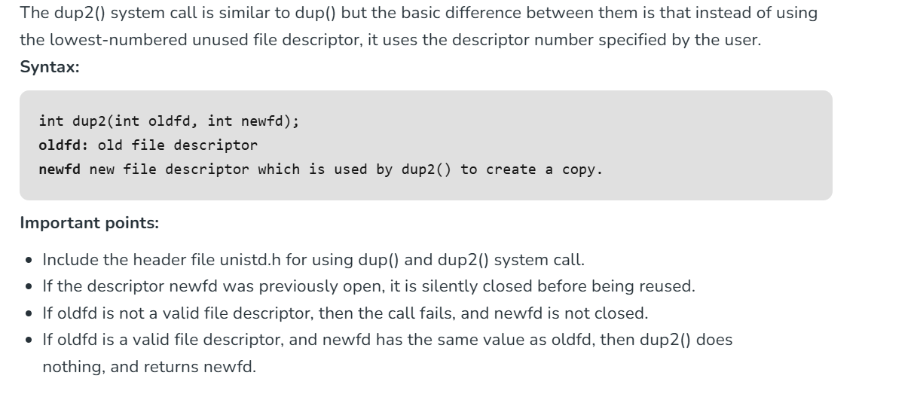
Dup2

Slide 25
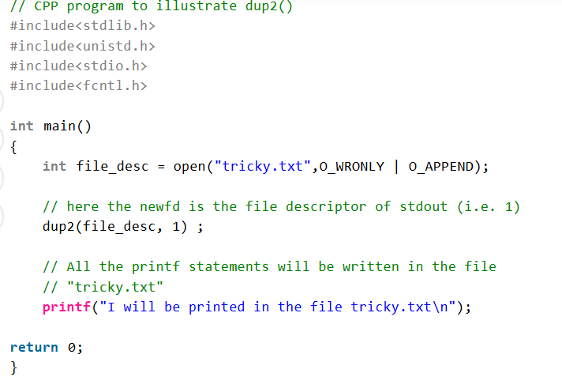
Dup2 Example

Slide 26
Dup2
DUP2 IS USEFUL
TO REDIRECT
STANDARD INPUT/OUTPUT
(STDIN, STDOUT, STDERR).

Slide 27
Redirecting stdout to a file:
int file = open("log.txt", O_WRONLY | O_CREAT | O_TRUNC, 0644);
dup2(file, 1); // Now stdout goes to log.txt
printf("This will be written to log.txt\n");

Slide 28
Redirecting stdin from file
int file = open("input.txt", O_RDONLY);
dup2(file, 0); // Now stdin reads from input.txt
char buffer[100];
scanf("%s", buffer); //Reads from input.txt instead of keyboard

Slide 29
Redirecting stderr to a file (error logging):
int file = open("errors.log", O_WRONLY | O_CREAT | O_APPEND, 0644);
dup2(file, 2); // stderr redirected to errors.log
fprintf(stderr, "This error message goes to errors.log\n");

